Slide 1

Naïve Bayes Algorithms
Author: Bùi Quốc Thịnh

Slide 2
Team members
Bùi Quốc Thịnh - 20520934
01
Nguyễn Huỳnh Hải Đăng - 20521159
02
Vũ Quốc Thái Bình - 20521119
03
Lê Nguyễn Tiến Đạt - 20521167
04

Slide 3
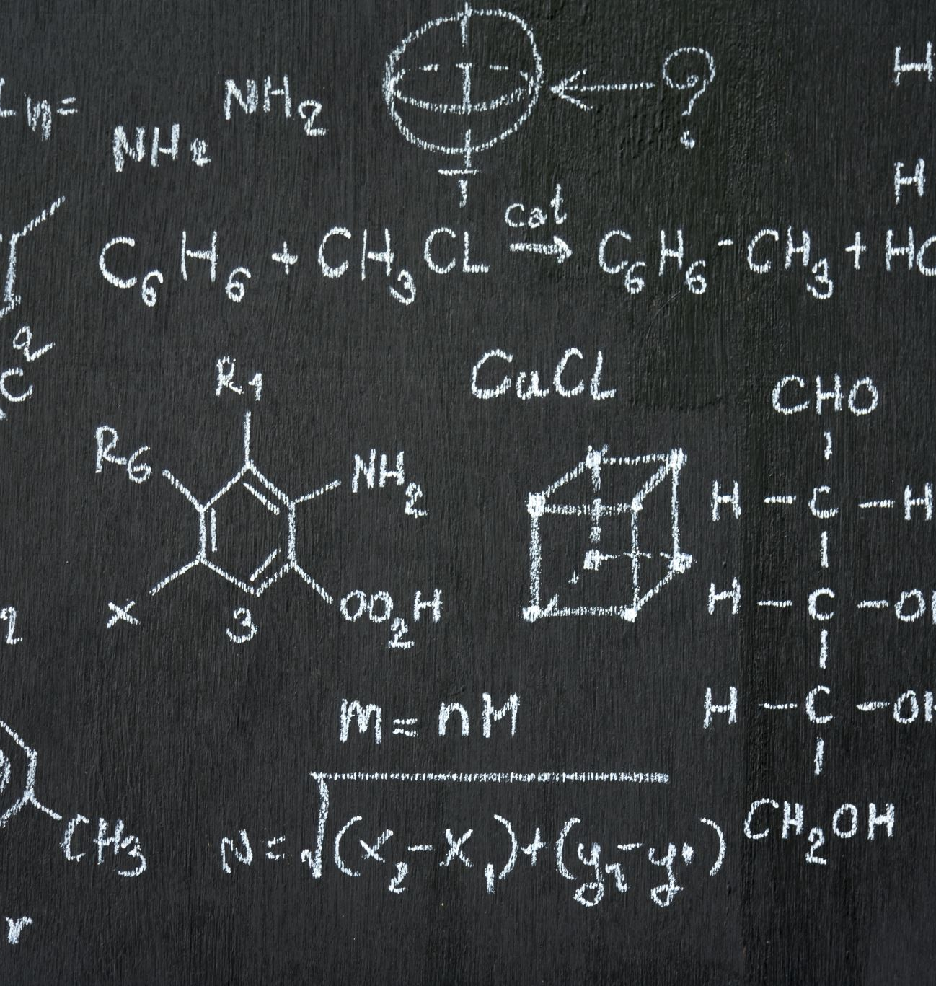
What is Naïve Bayes classifiers algorithm?
Naïve Bayes classifiers are a collection of classification algorithms based on Bayes’ Theorem. It is not a single algorithm but a family of algorithms where all of them share a common principle, that is every pair of features being classified is independent of each other.

Slide 4
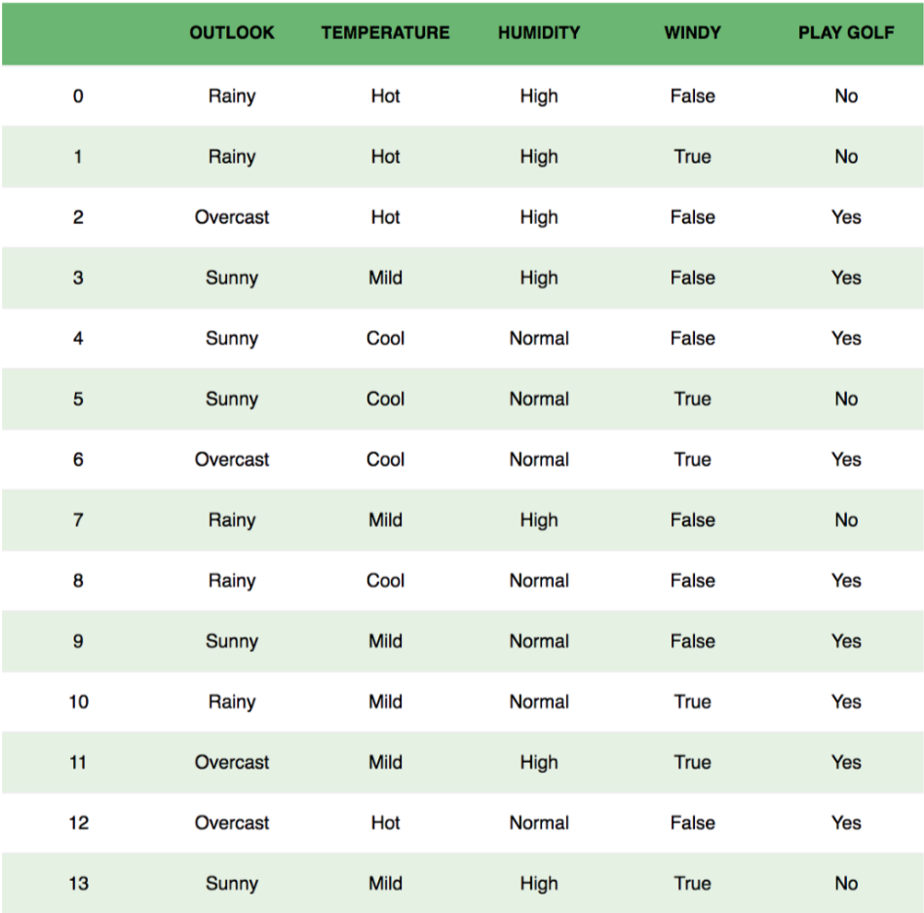
The weather conditions for playing a game of golf

Slide 5
Assumptions
The fundamental Naive Bayes assumption is that each feature makes an:
Independent
Equal
The temperature being ‘Hot’ has nothing to do with the humidity or the outlook being ‘Rainy’ has no effect on the winds. Hence, the features are assumed to be independent.
Knowing only temperature and humidity alone can’t predict the outcome accurately. None of the attributes is irrelevant and assumed to be contributing equally to the outcome.
Note: The assumptions made by Naive Bayes are not generally correct in real-world situations. In-fact, the independence assumption is never correct but often works well in practice.

Slide 6
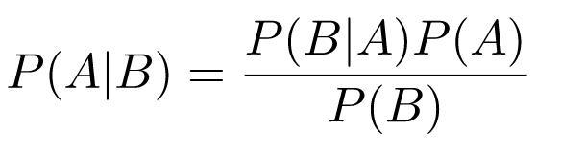
Bayes’ Theorem
Bayes’ Theorem finds the probability of an event occurring given the probability of another event that has already occurred.
Probability of event A, given the event B is true. Event B is also termed as evidence.
P(A) is the prior probability of A which is the probability of event before evidence is seen.
P(A|B) is a posteriori probability of B which is the probability of event after evidence is seen.

Slide 7
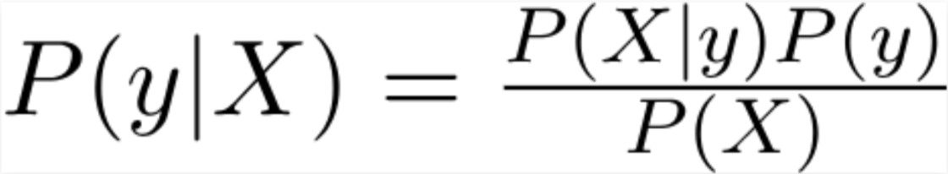
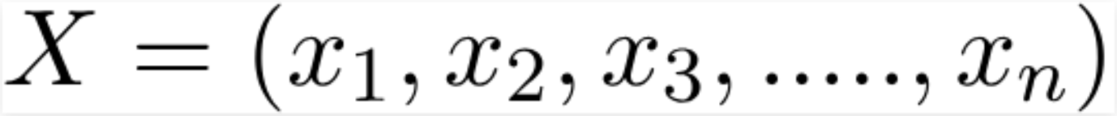
Rewritten Bayes’ Theorem
y is class variable (play golf).
X is a dependent feature vector
where:
X1 is outlook
X2 is temperature
X3 is humidity
X4 windy

Slide 8
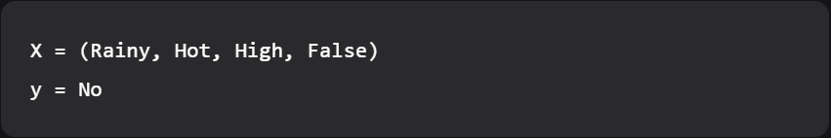
Example
P(y|X) here means the probability of “Not playing golf”.
The weather conditions are:
“Rainy outlook”
“Temperature is hot”
“high humidity”
“no wind”

Slide 9
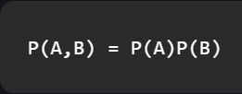
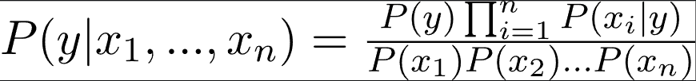
Naïve Assumption
If any two events A and B are independent, then,
The result:
which can be expressed as:
as the denominator remains
constant for a given input,
we can remove that term:

Slide 10
Find the probability of given set of inputs for all possible values of the class variable y and pick up the output with maximum probability
P(y) is also called class probability.
P(xi | y) is called conditional probability.
The different naive Bayes classifiers differ mainly by the assumptions they make regarding the distribution of P(xi | y).

Slide 11
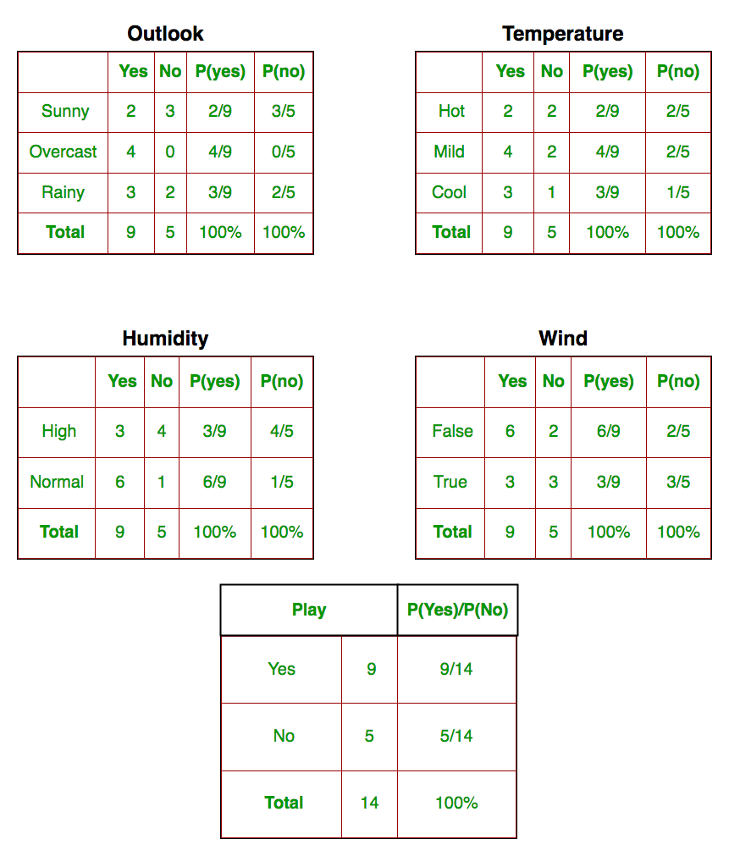
Apply the above formula manually on our weather dataset
Calculated P(xi | yj) for each xi in X and yj in y manually in the tables 1-4.
For example, probability of playing golf given that the temperature is cool, which is P(temp. = cool | play golf = Yes) = 3/9.
Find class probabilities (P(y)) (table 5).
For example, P(play golf = Yes) = 9/14.

Slide 12

Test on a new set of features
Probability of playing golf:
Probability to not play golf:
Proportional probabilities:
And:

Slide 13
Now since
A probability by making the sum equal to 1 (normalization):
And
Since
So, prediction that golf would be played is ‘Yes’.

Slide 14
Types of Naive Bayes Classifier
Gaussian Naïve Bayes
Multinomial Naïve Bayes
Bernoulli Naïve Bayes

Slide 15
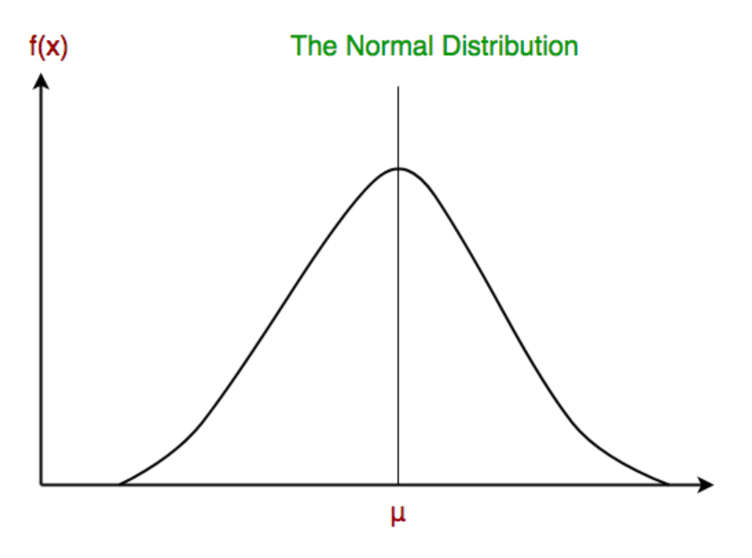
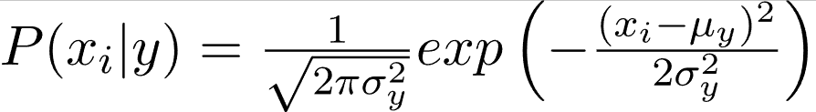
Gaussian Naïve Bayes
In Gaussian Naive Bayes, continuous values associated with each feature are assumed to be distributed according to a Gaussian distribution.
Conditional probability:

Slide 16
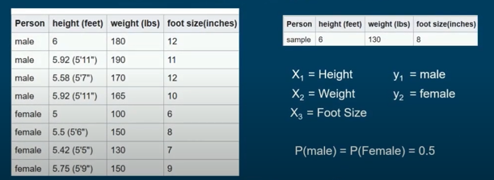
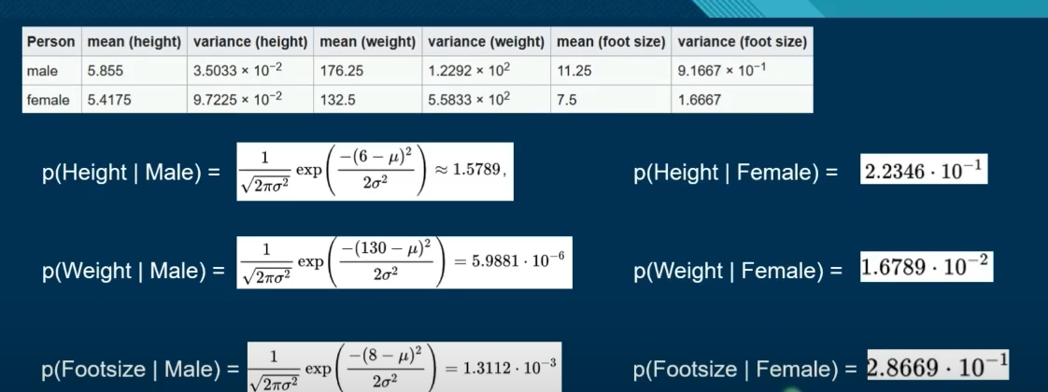
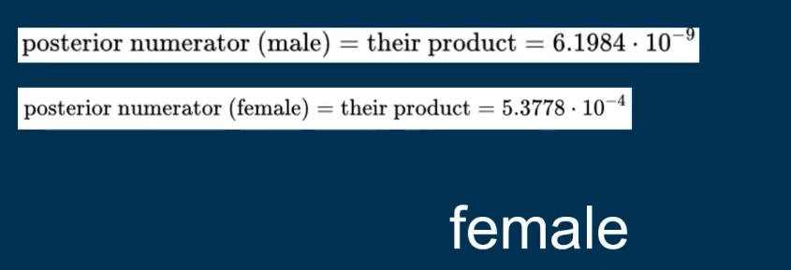
Example

Slide 17
Multinomial Naïve Bayes
Feature vectors represent the frequencies with which certain events have been generated by a multinomial distribution. This is the event model typically used for document classification, whether a document belongs to the category of sports, politics, technology etc.
The features/predictors used by the classifier are the frequency of the words present in the document.

Slide 18
Bernoulli Naïve Bayes
In the multivariate Bernoulli event model, features are independent booleans (binary variables) describing inputs.
Like the multinomial model, this model is popular for document classification tasks, where binary term occurrence features are used rather than term frequencies.
The parameters that we use to predict the class variable take up only values yes or no, for example if a word occurs in the text or not.

Slide 19
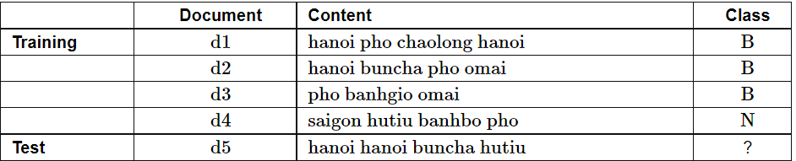


Example

Slide 20
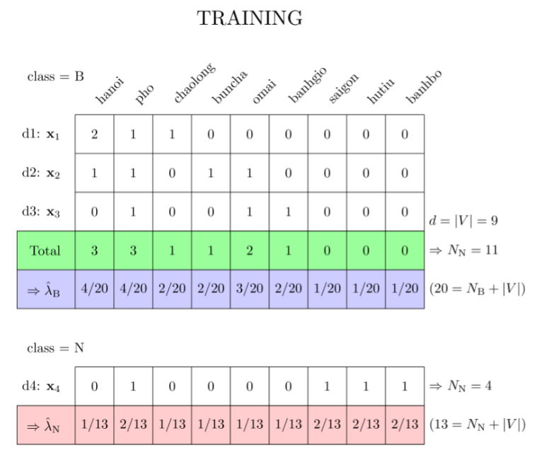
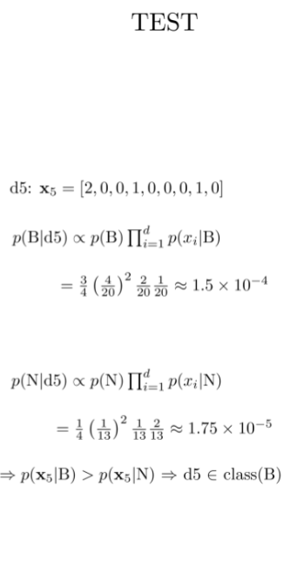

Multinomial Naïve Bayes

Slide 21
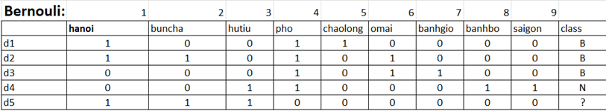

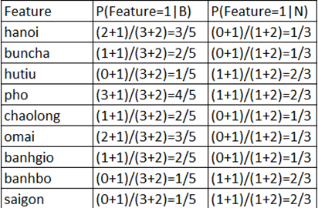
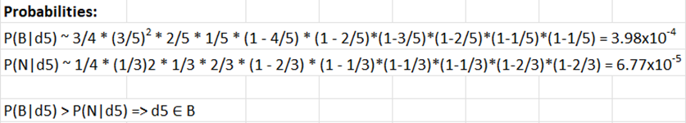

Bernoulli Naïve Bayes

Slide 22
Pros and Cons
Pros
conS
Naïve Bayes classifiers have worked quite well in many real-world situations, famously document classification and spam filtering.
They require a small amount of training data to estimate the necessary parameters.
Naïve Bayes learners and classifiers can be extremely fast compared to more sophisticated methods.
The requirement of predictors to be independent. In most of the real-life cases, the predictors are dependent, this hinders the performance of the classifier.
If categorical variable has a category (in test data set), which was not observed in training data set, then model will assign a 0 (zero) probability and will be unable to make a prediction. This is often known as “Zero Frequency”.

Slide 23
Pros and Cons
PROS
CONS
It performs well in case of categorical input variables compared to numerical variable(s). For numerical variable, normal distribution is assumed.
Naïve Bayes is also known as a bad estimator, so the probability outputs from predict_proba are not to be taken too seriously.

Slide 24
Applications of Naïve Bayes Algorithms
Real time Prediction
Multi class Prediction
Text classification/ Spam Filtering/ Sentiment Analysis
Recommendation System

Slide 25

THE END
Let’s go to code implementation

